Slide 1

OOPS in PYTHON
From Concepts to Clean, Resuable Code
Object-Oriented Programming System (OOPS) is a programming paradigm that organizes code using objects and classes instead of only functions and logic.
In OOPS, a program is divided into small, reusable, and manageable units called objects.
Each object represents a real-world entity and contains both data (variables) and behavior (methods).
~ Presented by Rupali Shewale

Slide 2
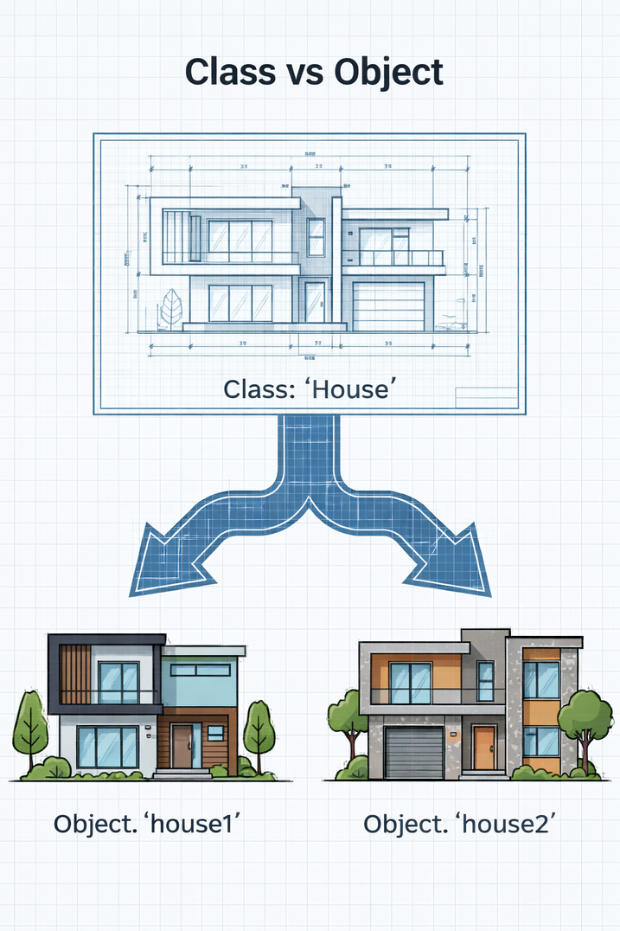
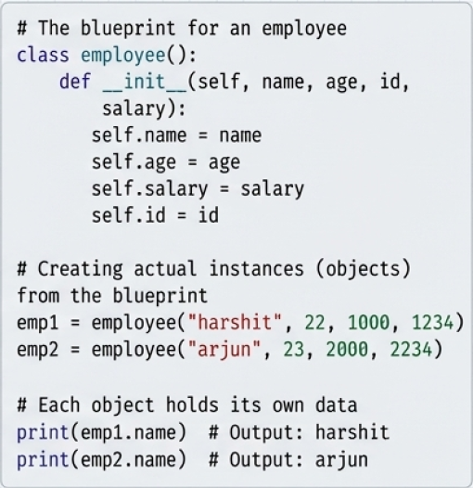
The Fundamental Unit : Class and Object
Class
The Code
A class is a blueprint or template used to define the structure and behavior of objects.
A class itself does not represent a real entity
Object
An object is an instance of a class.
It represents a real-world entity created using the class blueprint.

Slide 3
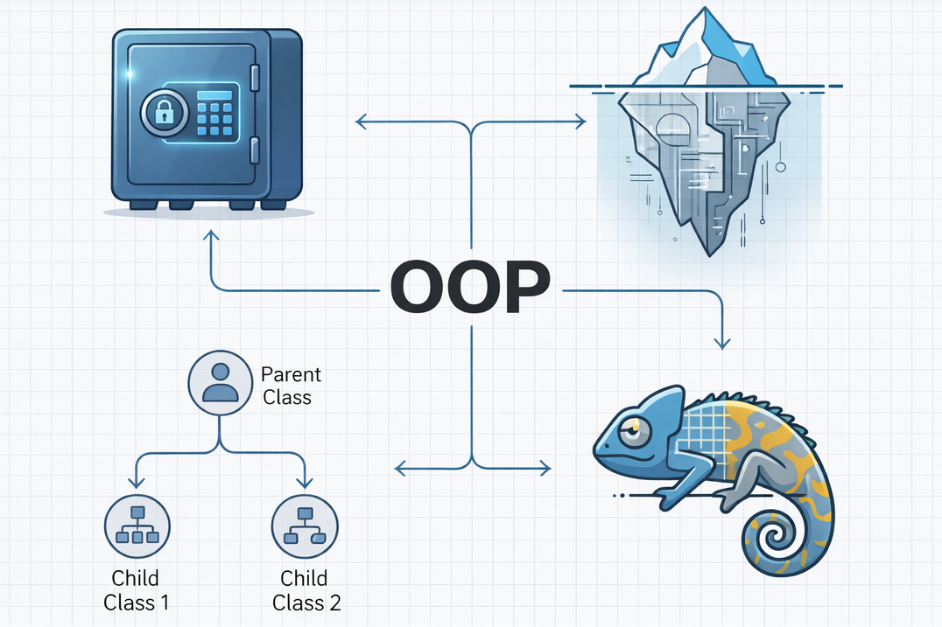
Four Pillars of OOP
ENCAPSULATION
ABSTRACTION
Building data and the methods that operate on it together, protecting data from outside interference
Hiding complexity and showing only the essential features of an object to the user
INHERITANCE
POLYMORPHISM
Reusing code by allowing a new class to adopt the properties and methods of an existing one
Allowing an object to take on many forms or a single method to act differently in different contexts.

Slide 4
Pillar 1 : Encapsulation
Encapsulation is the OOP principle of binding data (variables) and methods (functions) together into a single unit called a class, while restricting direct access to the data.
Access Modifiers in Python
Python provides access control using naming conventions:
Public → variable (Accessible everywhere)
Protected → _variable (Accessible within class and subclasses)
Private → __variable (Accessible only inside the class)
It ensures that object data cannot be modified directly from outside the class and can be accessed only through controlled methods.
Why Encapsulation is Needed
Protects sensitive data from unauthorized access
Prevents accidental modification of object data
Improves data security and reliability
Getter and Setter (Controlled Access)
Getter → Used to read private data
Setter → Used to modify private data safely
Ensures validation before updating values

Slide 5
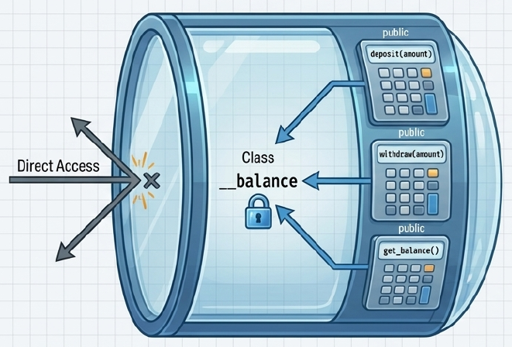
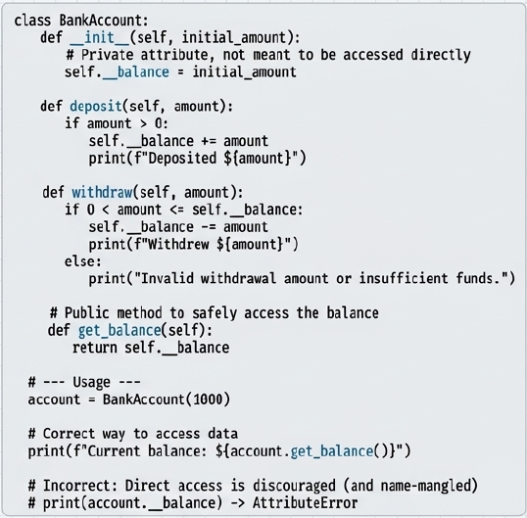
__balance is private, so it cannot be accessed directly.
Balance is accessed and updated only through methods.
This protects data and ensures controlled access.

Slide 6
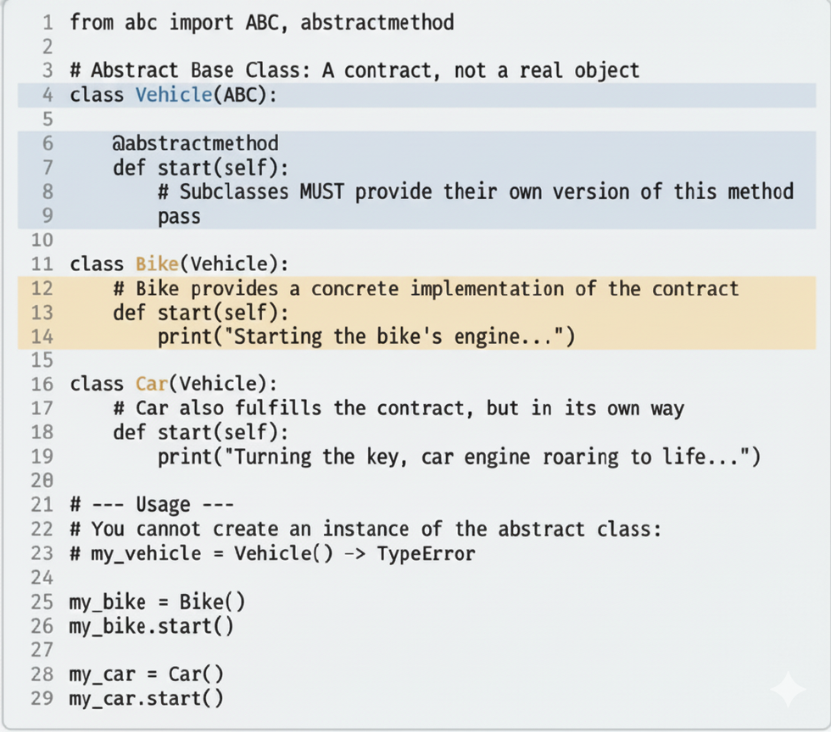
Pillar 2 : Abstraction
Abstraction is the OOP principle of hiding internal implementation details and showing only essential features to the user.
The user knows what an object does, not how it does it.
In Python, Abstract base Classes (ABCs) from abc module are used to create inetrfaces that subclasses must implement

Slide 7
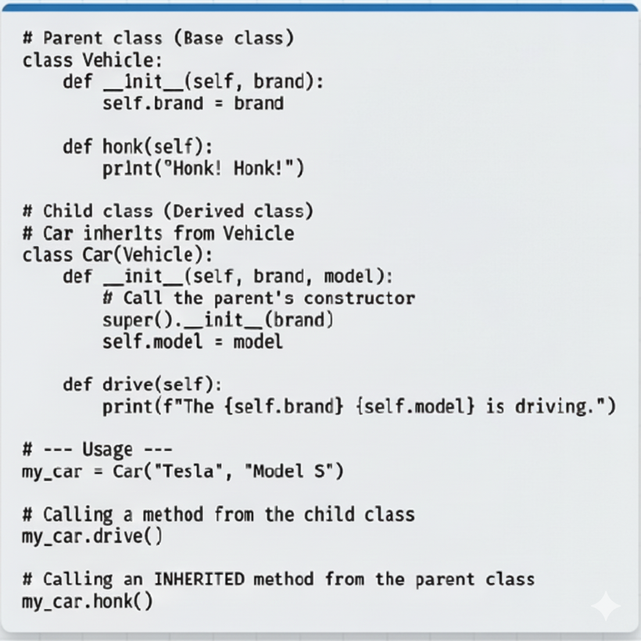
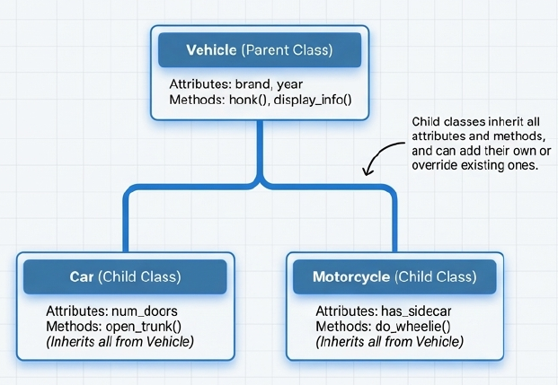
Pillar 3 : Inheritence
Inheritance is an OOP principle where a child class acquires the properties and methods of a parent class.
It allows code reuse, logical hierarchy, and easy extension of functionality.

Slide 8
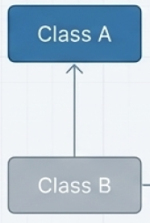
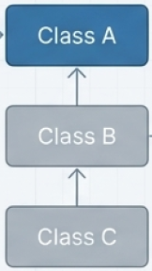
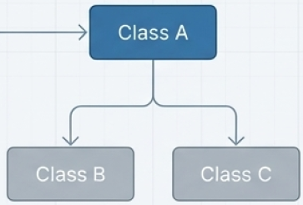
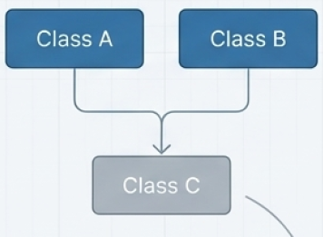
Types of Inheritence
Single Inheritance
Multilevel Inheritence
Hierarchical Inheritence
Multiple Inheritence
A Child class inherits from a single parent class.
e.g. ‘Car’ inherits from ‘Vehicle’
A Child class inherits from a child class, creating grandchild relaion
e.g. ‘ElectricCar’ inherits from ‘Car’, which inherits from ‘Vehicle’
Multiple classes inherits from a single parent class
e.g. ‘Car’, ‘bike’ inherits from ‘Vehicle’
A child class inherits from more than one parent class
e.g. ‘AmphibiousVehicle’ could inherit from ‘Car’ and ‘Boat’

Slide 9
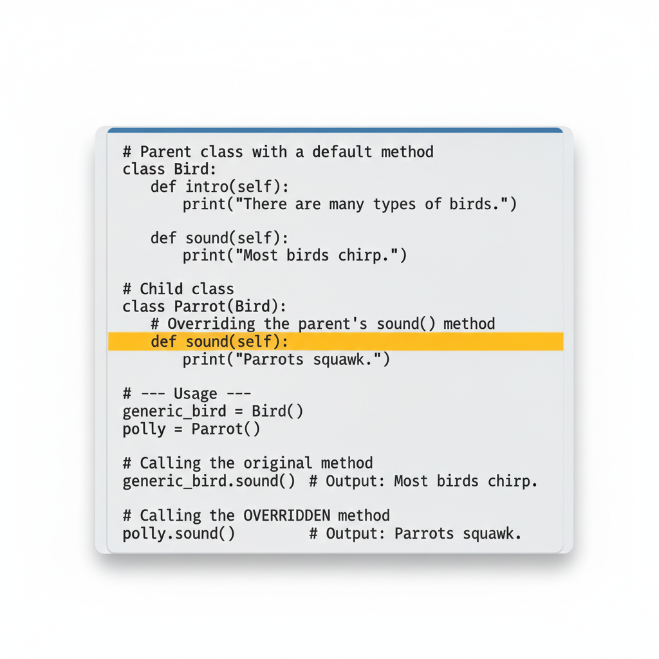
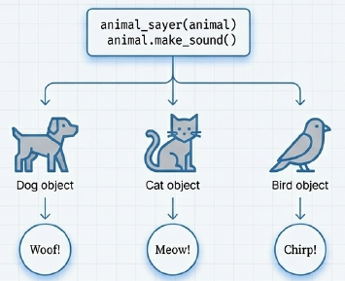
Pillar 4 : Polymorphism
Polymorphism means “one interface, many forms.”
The same method name can perform different actions depending on the object or context.
The method call is resolved at runtime based on the object.

Slide 10
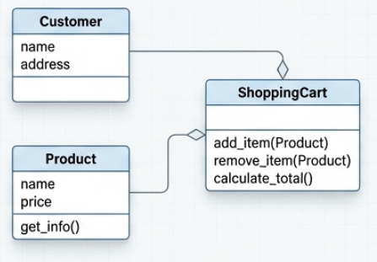
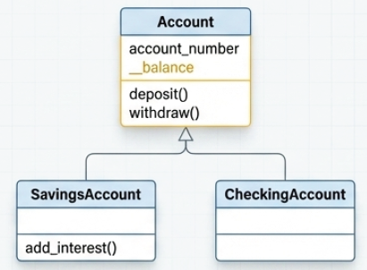
From Pillars to Projects
E-Commerce Platform
Banking Application
Encapsulation: The ShoppingCart protects its list of items, which can only be modified via add_item() or remove_item() methods
Abstraction : A checkout() method hides the complexity of payment processing, inventory updates, shiipng logistics from the customer
Inheritance : SavingsAccount and CheckingAccount both inherit common functionality from a base Account class, reducing code duplication
Polymorphism : A process_transaction() function cound handle Transaction object types in unique ways through a single interface

Slide 11
Thankyou

